Slide 1
Algorithmics on Database - Working on Internal Tables -

Slide 2
Contents
Operations on Internal Tables
Add information – APPEND, INSERT
Get information – READ
Change information – MODIFY
Remove information – DELETE
Sort information – SORT
Time to Practice

Slide 3
Operations on ITab

Slide 4
Program structure
REPORT... -> Program start
TYPES:… -> Type declaration
DATA:... -> Data declaration
SELECTION-SCREEN -> Parameters and select-options
... -> Start of processing
SELECT … INTO ITab -> Retrieve information from DB Tables based
on Selection Screen filters and other criteria
APPEND / INSERT / READ / -> Operations on ITab (processing the data)
MODIFY / DELETE
LOOP with WRITE -> Display the processed information

Slide 5
DATA objects
Initialize DATA objects
CLEAR structure. -> All fields of the structure get initial value
REFRESH itab. -> Deletes all rows of the internal table
IF <object> IS INITIAL.
ENDIF.
Iterate on Internal Tables.
LOOP AT itab INTO struc.
processing_bloc.
ENDLOOP.

Slide 6
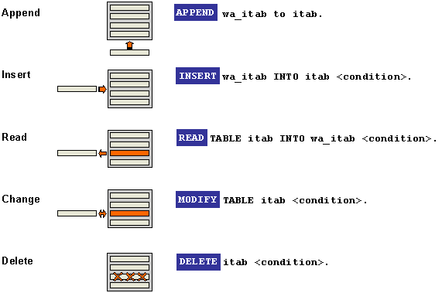
PROCESS SINGLE RECORDS

Slide 7
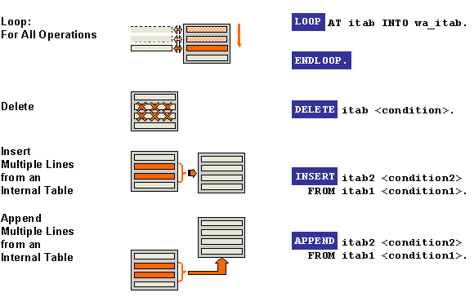
PROCESS MULTIPLE RECORDS

Slide 8
Operations on ITab APPEND

Slide 9
APPEND single record
APPEND [wa TO|INITIAL LINE TO] itab.
Appends a new line to the end of the internal table itab. You can only use this variant with index tables (standard or sorted table).
If you use INITIAL LINE TO, a line filled with the correct initial value for the type is added.

Slide 10
APPEND multiple records
APPEND LINES OF itab1 [FROM idx1] [TO idx2] TO itab2.
Appends the internal table itab1 or a block of lines from itab1 to the end of the internal table itab2. You can only use this variant with index tables (standard or sorted table). By specifying FROM idx1 or TO idx2, you can restrict the line area taken from the source table itab1. If there is no FROM specification, it begins with the first line of itab1. If there is no TO specification, it ends with the last line of itab1. This means that the complete table is appended if neither a FROM nor a TO is specified.

Slide 11
APPEND - example
DATA: t_scarr TYPE TABLE OF scarr,
s_mara TYPE scarr.
s_scarr-carrid = ‘LH'.
APPEND s_scarr TO t_scarr .
LOOP AT t_scarr INTO s_scarr.
WRITE: / ‘Airline code' , s_scarr-carrid.
ENDLOOP.

Slide 12
Operations on ITab INSERT

Slide 13
INSERT single record
INSERT [wa INTO|INITIAL LINE INTO] itab [INDEX idx].
Inserts a new line in the internal table itab using an explicit or implicit index specification. You can only use this variant with index tables (standard or sorted tables).
You use INDEX idx to specify the table index before which the line is inserted into itab. If the table has idx - 1 entries, the line is appended to the end of the table. If you are adding entries to an index table using a LOOP, you can leave out the INDEX idx specification. The source table is inserted before the current line in the LOOP (implicit index specification).

Slide 14
INSERT multiple records
INSERT LINES OF itab1 [FROM idx1] [TO idx2] INTO itab2 [INDEX idx3].
Inserts the internal table itab1 or an extract of it into the internal table itab2. This operation is the same as using a loop at the source area and inserting the entries into the target table line-by-line.
If you are using a LOOP you can omit the INDEX idx3 specification. The entry is then inserted in the target table before the current LOOP line.

Slide 15
INSERT - example
DATA: t_scarr TYPE TABLE OF scarr,
s_scarr TYPE scarr.
s_scarr-carrid = ‘LH'.
APPEND s_scarr TO t_scarr.
s_scarr-carrid = ‘UA’.
INSERT s_scarr INTO t_scarr INDEX 1.
LOOP AT t_scarr INTO s_scarr.
WRITE: / ‘Airline code' , s_scarr-carrid.
ENDLOOP.

Slide 16
Operations on ITab MODIFY

Slide 17
MODIFY single record
MODIFY itab [FROM wa] [INDEX idx] [TRANSPORTING f1 ... fn].
Changes a single entry in the internal table itab, specifying the key explicitly or implicitly. You can only use this variant with index table (standard or sorted tables). If you specify "FROM wa", the new values are taken from the work area wa. If you do not specify FROM, the header line of itab is used as the work area. You can use "INDEX idx" to specify the table index of the line you want to change. This may be omitted within a LOOP at an internal table. In this case, the current table line is changed. The INDEX specification can come before the FROM addition.

Slide 18
MODIFY single record
If you specify " TRANSPORTING f1 ... fn", only components f1, f2, ... of the work area are copied into the table. You can also specify components dynamically in the form (name). The actual component name is then taken from the field name at runtime. If name contains an invalid component name, the system triggers a runtime error.

Slide 19
MODIFY multiple records
MODIFY itab [FROM wa] TRANSPORTING f1 ... fn WHERE cond.
Changes several entries in the internal table itab. You can use this variant for any table. You can use " FROM wa" and "TRANSPORTING f1 ... fn" as in variant 1.

Slide 20
MODIFY - example
DATA: t_scarr TYPE TABLE OF scarr,
s_scarr TYPE scarr.
s_scarr-carrid = ‘LH'.
APPEND s_scarr TO t_scarr.
s_scarr-carrid = ‘UA'.
MODIFY t_scarr FROM s_scarr INDEX 1
TRANSPORTING carrid.
LOOP AT t_scarr INTO s_scarr.
WRITE: / ‘Airline code' , s_scarr-carrid.
ENDLOOP.

Slide 21
Operations on ITab DELETE

Slide 22
DELETE
DELETE TABLE itab WITH TABLE KEY k1 = v1 ... kn = vn.
Deletes generically from an internal table. You can use this variant for any tables. The variant is a single command that deletes the table line with the key values k1 = v1 ....kn = vn. If there is more than one line with the specified key, only the first one is deleted. The table key must be specified fully, and each component of the key ki must be compatible with its corresponding value vi.
DELETE TABLE itab [FROM wa].
The values for the table key are taken from the corresponding components of the (structured) field wa. The field must be compatible with the table line of itab. This method allows you to delete from a table without the table key having to be known in advance

Slide 23
DELETE
DELETE itab INDEX idx.
Deletes the idx-th entry of the internal table itab.
DELETE itab FROM idx1 TO idx2.
Deletes the range of lines from index idx1 to idx2 from the internal table itab. You can only use this variant with index tables (standard or sorted tables). You must specify at least one of the parameters FROM idx1 or TO idx2. If you omit the FROM parameter, the system deletes the lines from the start of the table to idx2. If you omit the TO parameter, the system deletes from line idx1 to the end of the table. The starting line idx1 must be greater than 0.

Slide 24
DELETE
DELETE itab WHERE logexp.
Deletes all of the entries from the internal table itab that satisfy the condition logexp. The condition logexp can be almost any logical expression. The only restriction is that the first field in each comparison must be a component of the line structure of the internal table itab.
DELETE ADJACENT DUPLICATES FROM itab [COMPARING f1..f2].
Deletes adjacent duplicate entries from the internal table itab. If there are n duplicate entries in succession, the first entry is retained, and the following n-1 entries are deleted.
Two lines of the internal table itab are regarded as duplicates if they have identical contents in the fields f1, f2, ...

Slide 25
DELETE - example
DATA: t_scarr TYPE TABLE OF scarr,
s_scarr TYPE scarr.
WRITE: / 'Before: '.
LOOP AT t_scarr INTO s_scarr.
WRITE: / ‘Airline code' , s_scarr-carrid.
ENDLOOP.
DELETE t_scarr INDEX 2.
DELETE t_scarr WHERE carrid = ‘LH’.
DELETE t_scarr FROM 4 TO 7.
WRITE: / 'After: '.
LOOP AT t_scarr INTO s_scarr.
WRITE: / ‘Airline code' , s_scarr-carrid.
ENDLOOP.

Slide 26
Operations on ITab SORT

Slide 27
SORT
SORT itab.
The entries in the internal table are sorted in ascending order using the key from the table definition.
SORT itab BY f1 f2 ... fn.
Uses the sort key defined by the sub-fields f1, f2, ..., fn of the table itab instead of the table key. The fields can be of any type; even number fields and tables are allowed.

Slide 28
SORT
Additions :
... ASCENDING
Sorts in ascending order. This is also the default if no sort order is specified directly after SORT. For this reason, it is not necessary to specify ASCENDING explicitly as the default sort order. With the addition BY, you can also specify ASCENDING directly after a sort field to define ascending order explicitly as the sort sequence for this field.
... DESCENDING
Sorts in descending order.
With the addition BY, you can also specify DESCENDING directly after a sort field.

Slide 29
SORT – examples
SORT itab.
SORT itab DESCENDING.
SORT itab BY field1 field2 ASCENDING.
SORT itab BY field1 field2 ASCENDING field 3 DESCENDING.

Slide 30
Operations on ITab READ

Slide 31
READ single record
READ TABLE itab WITH KEY k1 = v1 ... kn = vn INTO wa [BINARY SEARCH].
Reads one line of the internal table into a structure basef on the condition specified.
If you use the ... BINARY SEARCH addition, the system uses a binary search. Otherwise, the search is sequential. This assumes that the internal table is sorted in ascending order in the sequence of the specified key fields.

Slide 32
READ - example
DATA: t_scarr TYPE TABLE OF scarr,
s_scarr TYPE scarr.
READ TABLE t_scarr INTO s_scarr
WITH KEY carrid = ‘LH’.
IF sy-subrc = 0.
WRITE: / ‘Airline code' , s_scarr-carrid.
ENDIF.
SORT t_scarr BY carrid.
READ TABLE t_scarr INTO s_scarr
WITH KEY carrid = ‘LH’ BINNARY SEARCH.
IF sy-subrc = 0.
WRITE: / ‘Airline code' , s_scarr-carrid.
ENDIF.

Slide 33
Time to Practice

Slide 34
Time to practice: Exercise
1. Create a program named ZZuser_C7 (user is your login user; eg:g001) with the following selection screen
Select name | Data type | TYPE | Mandatory | Default | Description
s_carrid | SPFLI-CARRID | Select option | X | LH | Airline code
s_connid | SFLIGHT-CONNID | Select option |  |  | Flight Connection Number
s_fldate | SFLIGHT-FLDATE | Select option |  |  | Flight date
s_from | SPFLI-CITYFROM | Select option |  |  | Departure city
s_to | SPFLI-CITYTO | Select option |  |  | Arrival city

Slide 35
Time to practice: Exercise
2. Select in an internal table GT_SFLIGHT all the flights using the following conditions:
SFLIGHT-CARRID in s_carrid
SFLIGHT-CONNID in s_connid
SFLIGHT-FLDATE in s_fldate
SPFLI-CITYFROM in s_from
SPFLI-CITYTO in s_to
The internal table should contain the following fields:
CARRID (table SFLIGHT)
CONNID (table SFLIGHT)
FLDATE (table SFLIGHT)
CITYFROM (table SPFLI)
CITYTO (table SPFLI)
DEPTIME (table SPFLI)
ARRTIME (table SPFLI)
PRICE (table SFLIGHT)
CURRENCY (table SFLIGHT)
PLANETYPE (table SFLIGHT)
SEATSMAX (table SFLIGHT)
SEATSOCC (table SFLIGHT)

Slide 36
Time to practice: Exercise
3. From the flights already selected, display the flight with the most empty seats (SEATSMAX – SEATSOCC). Please use an intermediate internal table GT_SFLIGHT_DET with the following structure:
CARRID (table SFLIGHT)
CONNID (table SFLIGHT)
FLDATE (table SFLIGHT)
SEATSDIF (table SFLIGHTS)
DIF_FLAG (CHAR1)
In order to fill table GT_SFLIGHT_DET do the following steps:
Iterate on the initial internal table GT_SFLIGHT using the LOOP syntax:
a. CLEAR the GS_SFLIGHT_DET structure;
b. Copy the values from fields CARRID, CONNID, FLDATE from GS_SFLIGHT into GS_SFLIGHT_DET;
c. Calculate the value of the field SEATSDIF (SEATSMAX – SEATSOCC);
d. Add the structure GS_SFLIGHT_DET using APPEND if SY-TABIX is an odd number and INSERT if SY-TABIX is an even number;
4. Sort the Itab GT_SFLIGHT_DET descending by field SEATSDIF;
5. Read and Display the first entry of the internal table

Slide 37
Optional – Exercise I
Create a program named ZZuser_C7_E1.
Define the following structure and internal table:
structure product:
id_prod: type n length 10
name_prod: type c length 40
qty: type p decimals 3
um: type c length 5
table : line structure product
a) Populate the previously defined internal table with information about 5 products;
b) Delete all products from the internal table for which the quantity = 0.
c) Declare following variables, and give them a value:
gv_id type n length 10
gv_name type c length 40
gv_qty type p decimals 2
gv_um type c length 5
Append the values entered for those values into the table.
Make sure an entry with the same id_prod does not already exist in the table.
Display all entries contained in the internal table.

Slide 38
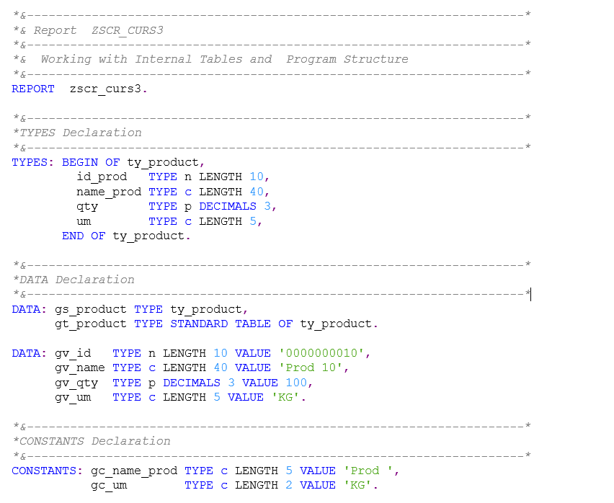
Solution: Declaration

Slide 39
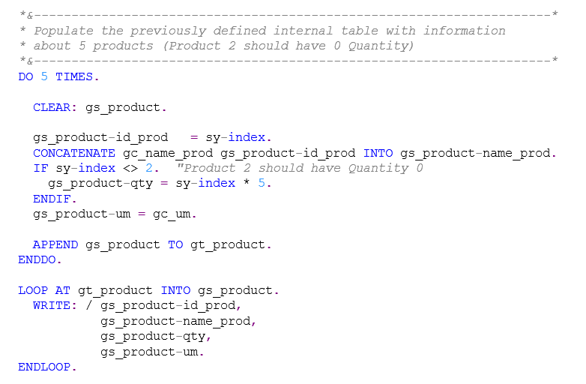
Solution: Point A

Slide 40
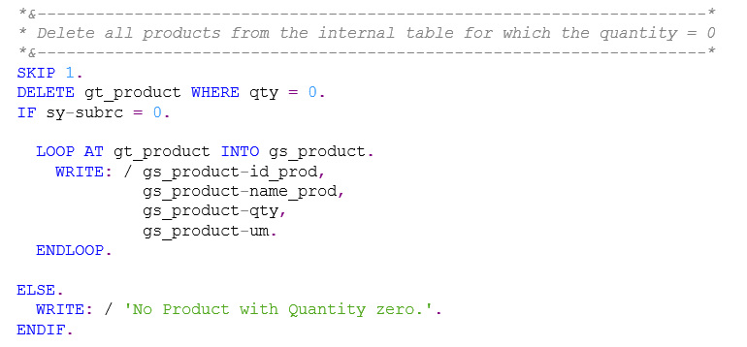
Solution: Point B

Slide 41
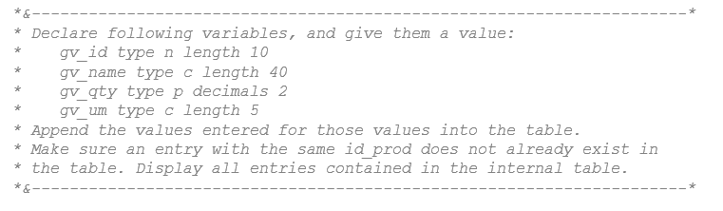
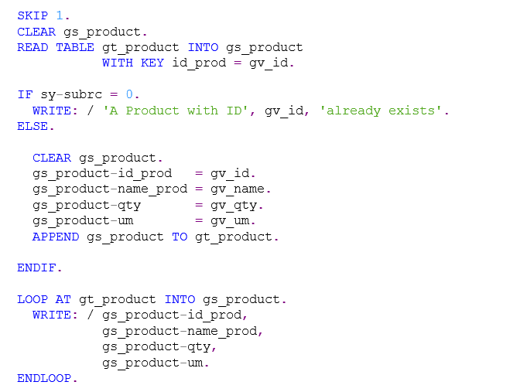
Solution: Point C

Slide 42
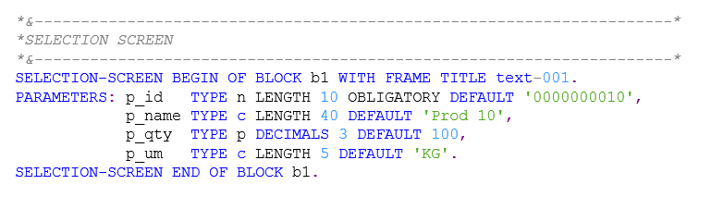
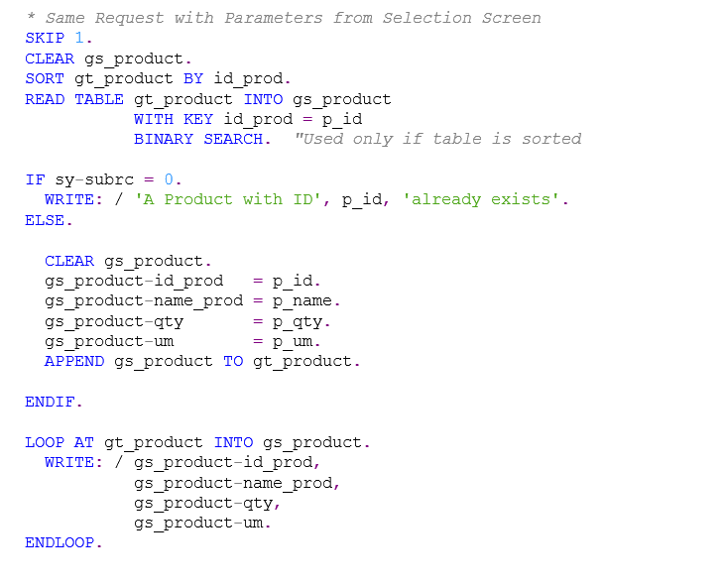
Solution: Point C with Selection Screen

Slide 43
Optional – Exercise II
Create a program named ZZuser_C7_E2.
Define the following structure and internal table:
structure INVOICE
sales_id: type n length 3
date: type d
prod_id: type n length 5
qty: type p decimals 2
price: type p decimals 2
um: type c length 5
table : line structure INVOICE
a) Populate the table with 10 Sales Invoices using the following rules:
* Sales ID should start from 1 (use consecutive numbers)
* Each Sales Invoice contains 5 products. Prod ID should be created by multiplying the Sales ID with 10 and adding consecutive numbers starting with 1 (eg: Sales ID = 001 will contain Prod ID: 00011, 00012, 00013, 00014, 00015)
* UM is always RON
* Invoices with EVEN Sales ID
* were recorded 15 days ago
* Qty = Prod ID * 5
* Price = Qty – 60*Sales ID (negative prices are not accepted; default value 10)
* Use APPEND to add this information to the internal TABLE

Slide 44
Optional – Exercise II
* Invoices with ODD Sales ID
* were recorded 30 days ago
* Qty = Prod ID * 5
* Price = Qty – 60*Sales ID (negative prices are not accepted; default value 10)
* Use INSERT to add this information to the internal TABLE
OBS: Use nested DO for implementing the request.
b) Define the following selection screen
p_salid: type n length 3, mandatory, default 100
p_prodid: type n length 5, mandatory, default 101
p_qty: type p decimals 2
p_price: type p decimals 2
Add the above Invoice position in the internal table. If the position already exists (Sales ID and Prod ID already exists) modify the Quantity and Price.
If Price not filled by user, use default value 10. Use current date for Date field and ‘RON’ for UM field.
Sort the internal table by Sales ID and Prod ID and display all the records.
c) BONUS: Display the Invoice with the highest amount (Invoice amount is calculated as sum of Qty * Price for all products from the Sales Invoice).

